Slide 1
AI-Based System for Identifying and blocking phishing attacks
Guided By : Prof. Nishith Kotak Neer Gosrani Digvijay Chavda 92110133009 92110133028

Slide 2
Content
Introduction
Requirement of your system
Common techniques used by AI for phishing detection
Flowchart / Block Diagram
Challenges
Conclusion / Future Work

Slide 3
Introduction
However, there are several tools and techniques to fight phishing.
Today we’ll focus on artificial intelligence (AI) and machine learning (ML).
Besides analyzing and categorizing email the moment it arrives, AI can do so on a larger scale much faster and more accurately when compared to the traditional model based on rules and filters.
Using database and big data analysis, it identifies spam, phishing, spear phishing, and other types of attacks by taking into account the message content and context.

Slide 4
Requirement of your system
Hardware Requirements:
Processor CPU - Intel Pentium Dual Core and Higher
Hard Disk capacity - 512MB Space required minimum
RAM - 4GB minimum
Software requirements
Programming language - Python
Operating system - Windows 8.1 or above
Google Colab, IDE - Anaconda , Python version 3.x

Slide 5
Common Techniques
Content analysis
Sender analysis
URL analysis
Behavioural analysis
Machine learning

Slide 6
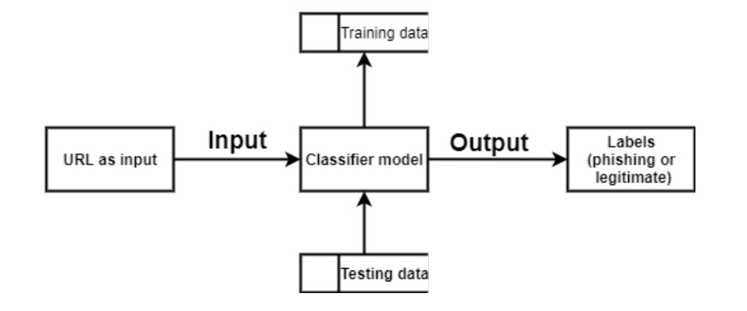
Flowchart / Block Diagram

Slide 7
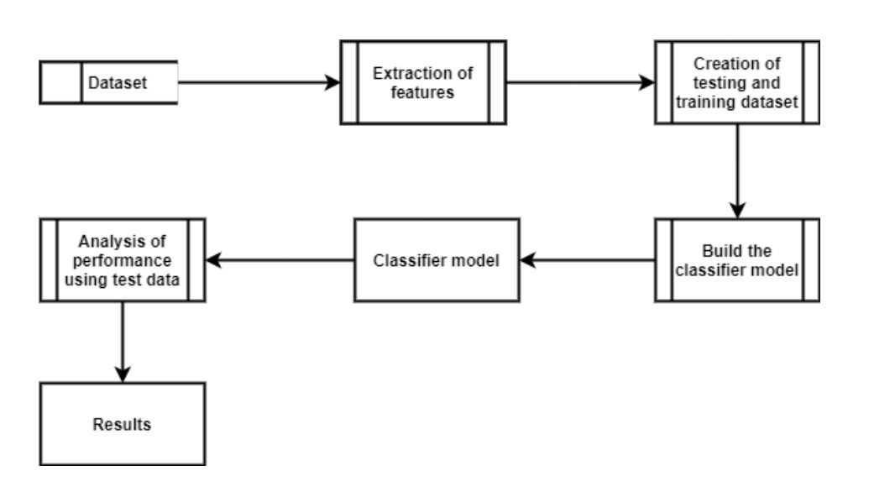
Flowchart / Block Diagram

Slide 8
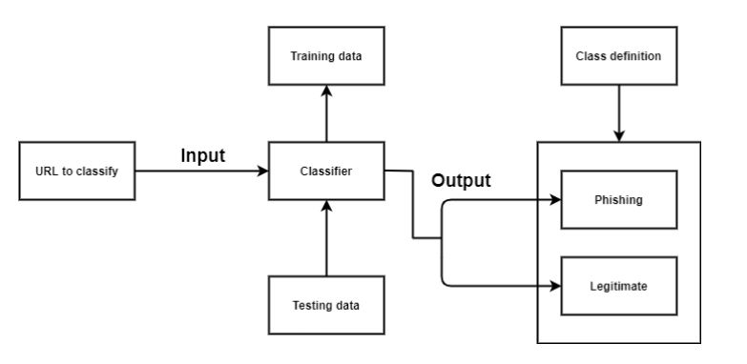
Flowchart / Block Diagram

Slide 9
Challenges
Finding the appropriate dataset.
Feature extraction required the study of various modules and understanding each module and getting the expected outcome from it.

Slide 10
Conclusion / Future Work
The proposed method used four machine learning classifiers to achieve this and a comparative study of the four algorithms was made.
A good accuracy score was also achieved.
The four algorithms used are Logistic Regression ,K-Nearest neighbour, Support Vector Machine, and
Conclusion & future works Detection of phishing websites using machine learning techniques decision Tree and Random Forest Classifier.
The accuracy score might vary while using other datasets and other algorithms might provide better accuracy than random forest classifier.
Random forest classifier is an ensemble classifier and hence the high accuracy.
This model can be deployed in real time to detect the URLs as phishing or legitimate.

